Slide 1
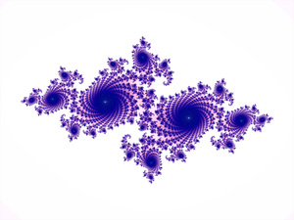
int W = 400,
H = W;
Circle C;
int Cx = 200,
Cy = 300,
D = 50;
void setup() {
size(W, H);
smooth();
C = new Circle(Cx, Cy, D, Red);
C.Show();
C.dx = 1;
C.dy = -1;
}
void draw() {
background(Yellow);
C.Show();
C.Move();
}
Circle1
class Circle {
int Cx, Cy;
int dx, dy;
int D;
color FillCol;
Circle(int Cx, int Cy, int D,
color FillCol) {
this.Cx = Cx;
this.Cy = Cy;
this.D = D;
this.FillCol = FillCol;
}
void Show() {
fill(FillCol);
translate(Cx, Cy);
ellipse(0, 0, D, D);
}
void Move() {
Cx += dx;
Cy += dy;
}
}
An alternative approach to a Circle class – we ‘go to where we want to draw the ellipse and draw it with centre ((0, 0) in that frame of reference.
Circle1
The ellipses’s position is given by (Cx, Cy) – the centre of the ellipse
Circle

Slide 2
int W = 800,
H = W;
Circle C;
Square S;
int Cx = 200,
Cy = 300,
D = 50;
int Sx = 200,
Sy = 50,
HS = 30;
void setup() {
size(W, H);
smooth();
C = new Circle(Cx, Cy, D, Red);
C.dx = 1;
C.dy = -2;
S = new Square(Sx, Sy, HS);
S.Col = Green;
S.dx = 1;
S.dy = 0;
background(Yellow);
C.Show();
S.Show();
}
Circle_Square1
boolean Q_Go = false;
void draw() {
if(Q_Go) {
background(Yellow);
C.Show();
C.Move();
S.Show();
S.Move();
}
}
void mousePressed() {
Q_Go = !Q_Go;
}
Let’s have a similar Square class
Circle_Square1
Circle
Square

Slide 3
class Square {
int Cx,
Cy;
int HS;
color Col;
int dx,
dy;
Square(int Cx, int Cy, int HS) {
this.Cx = Cx;
this.Cy = Cy;
this.HS = HS;
}
void Show() {
rectMode(CENTER);
translate(Cx, Cy);
fill(Col);
rect(0, 0, HS * 2, HS * 2);
}
void Move() {
Cx += dx;
Cy += dy;
}
}
Circle_Square1
This is new for Square – we go to where we want to draw the rectangle and draw it.
Circle_Square1
Circle
Square
Unless we code otherwise the position of the rectangle is given by its top left corner. Here we call rectMode(CENTER)to make the rectangle’s position the centre.

Slide 4
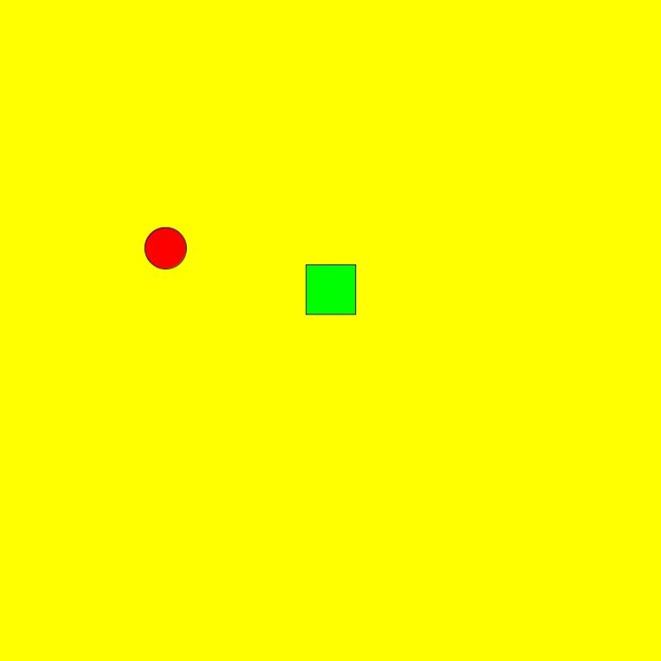
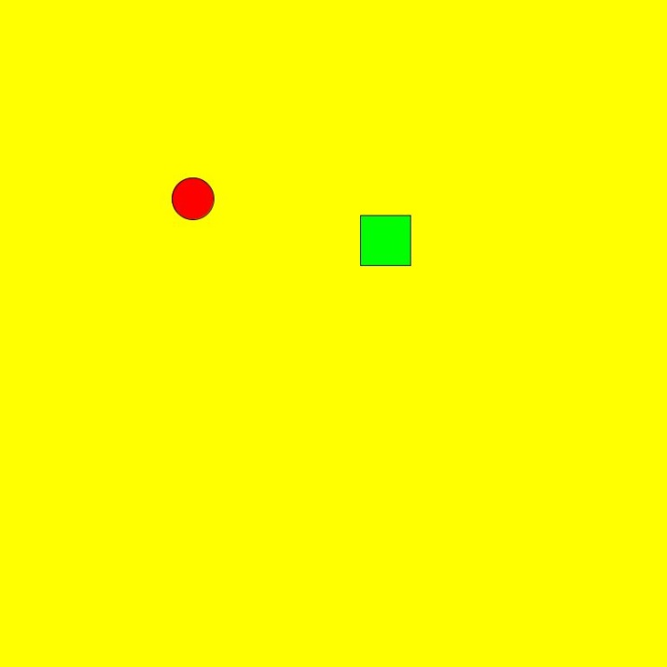
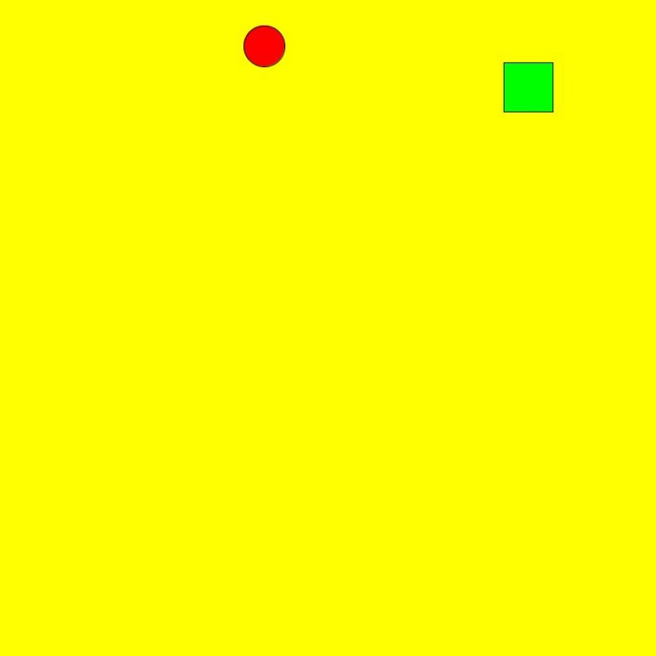
Circle_Square1
Before clicking mouse for Q_Go to become true
Circle_Square1
Circle
Square
int Cx = 200,
Cy = 300,
D = 50;
int Sx = 200,
Sy = 50,
HS = 30;
Surely the Square should be directly under the Circle?

Slide 5
Circle_Square1
void draw() {
if(Q_Go) {
background(Yellow);
C.Show();
C.Move();
S.Show();
S.Move();
}
}
Circle_Square1
Circle
Square
Circle
Square
void Show() {
fill(FillCol);
translate(Cx, Cy);
ellipse(0, 0, D, D);
}
void Show() {
rectMode(CENTER);
translate(Cx, Cy);
fill(Col);
rect(0, 0, HS * 2, HS * 2);
}
The translations are cumulative within the Processing draw() method. Once draw() finishes then the frame of reference is reset to the normal, untranslated frame of reference.

Slide 6

class Circle {
int Cx, Cy;
int dx, dy;
int D;
color FillCol;
Circle(int Cx, int Cy, int D, color FillCol) {
this.Cx = Cx;
this.Cy = Cy;
this.D = D;
this.FillCol = FillCol;
}
// PRE TRUE
// POST Circle drawn on canvas
void Show() {
fill(FillCol);
translate(Cx, Cy);
ellipse(0, 0, D, D);
translate(-Cx, -Cy);
}
void Move() {
Cx += dx;
Cy += dy;
}
}
Circle_Square2
Why not reverse the changes once we have drawn the shape?
Circle_Square2
Circle
Square
It works for this but it’s a bit of a hack!
Suppose that we had a complex object to draw using translate() many times. Then we would have to ensure we did all the inverses in the right order etc.

Slide 7
Circle_Square3
void setup() {
size(W, H);
smooth();
C = new Circle(Cx, Cy, D, Red);
C.dx = 1;
C.dy = -2;
S = new Square(Sx, Sy, HS);
S.Col = Green;
S.dx = 1;
S.dy = 0;
………………………………………..
}
void draw() {
if(Q_Go) {
background(Yellow);
pushMatrix();
C.Show();
popMatrix();
C.Move();
pushMatrix();
S.Show();
popMatrix();
S.Move();
}
}
pushMatrix() stores the current frame of reference on top of the stack. A stack is a first-in, last-out data structures
This means that however complex the transformations in frames of reference involved in C.Show() or S.Show() we simply get back to where we were with popMatrix().
FoR4
FoR3
FoR2
FoR1
popMatrix() restores the last stored frame of reference from the stack
This is a very simple example but we might stack several frames of reference

Slide 8
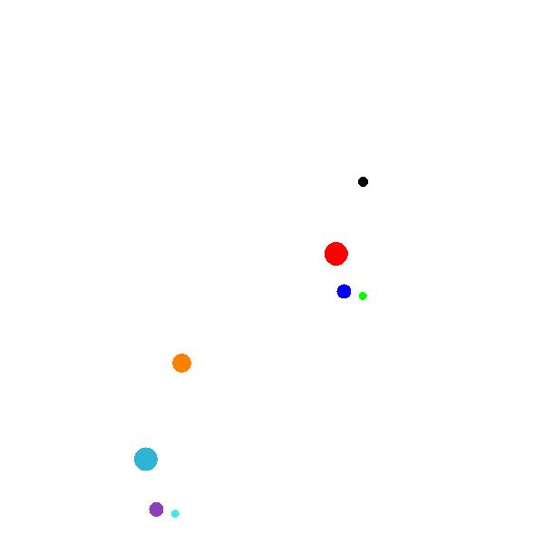
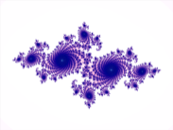
void draw() {
background(White);
pushMatrix();
fill(Black);
stroke(Black);
ellipse(400, 200, 10, 10);
translate(400, 200);
rotate(i * Unit);
fill(Red);
stroke(Red);
ellipse(60, 60, 25, 25);
translate(60, 60);
rotate(5 * i * Unit);
fill(Blue);
stroke(Blue);
ellipse(30, 30, 15, 15);
translate(30, 30);
rotate(10 * i * Unit);
stroke(Green);
fill(Green);
ellipse(15, 15, 8, 8);
popMatrix();
pushMatrix();
fill(Orange);
stroke(Orange);
ellipse(200, 400, 20, 20);
translate(200, 400);
rotate(i * Unit);
fill(C1);
stroke(C1);
ellipse(80, 80, 25, 25);
translate(80, 80);
rotate(5 * i * Unit);
fill(C2);
stroke(C2);
ellipse(40, 40, 15, 15);
translate(40, 40);
rotate(10 * i * Unit);
stroke(C3);
fill(C3);
ellipse(15, 15, 8, 8);
popMatrix();
i++;
}
Show this solar system..
Note: we are using the ellipse() method rather than the Circle class here for an easier demo
..then this one
SolarSystemPushPop1

Slide 9
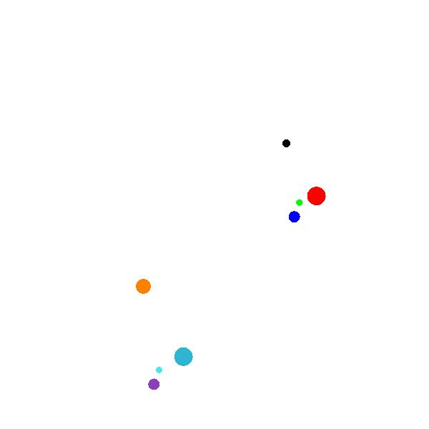
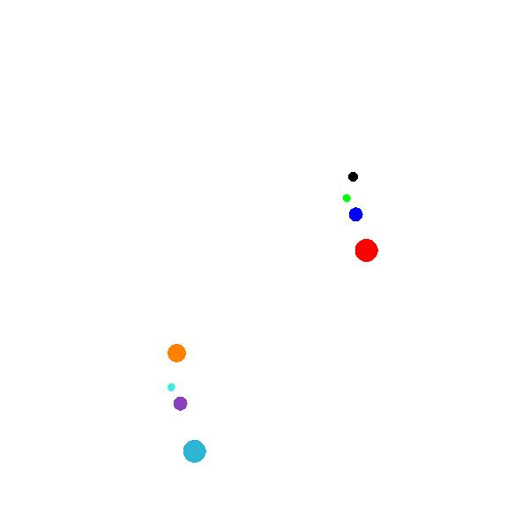
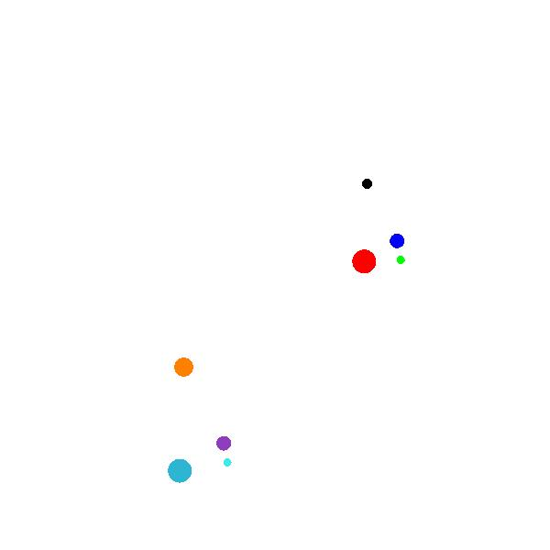
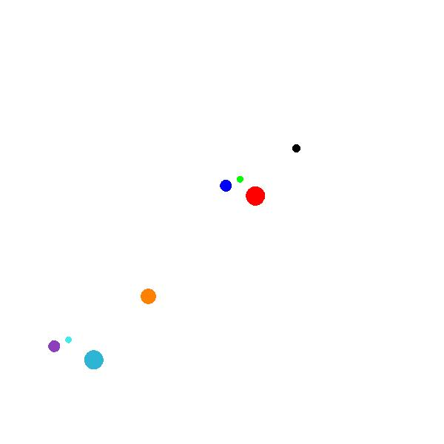
pushMatrix();
fill(Black);
stroke(Black);
ellipse(400, 200, 10, 10);
…………………………………………….
popMatrix();
pushMatrix();
fill(Orange);
stroke(Orange);
ellipse(200, 400, 20, 20);
…………………………..
popMatrix();
SolarSystemPushPop1

Slide 10
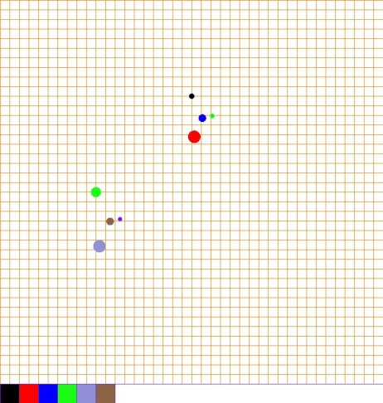
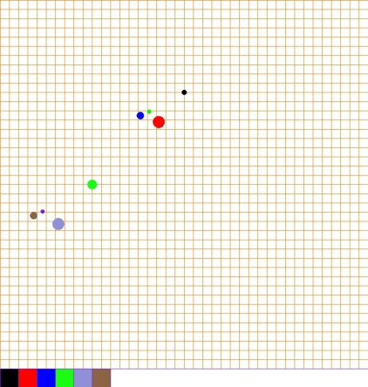
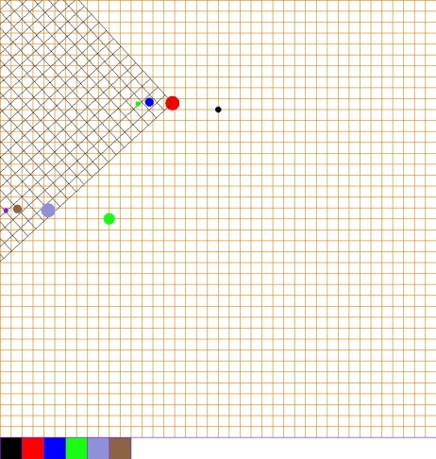
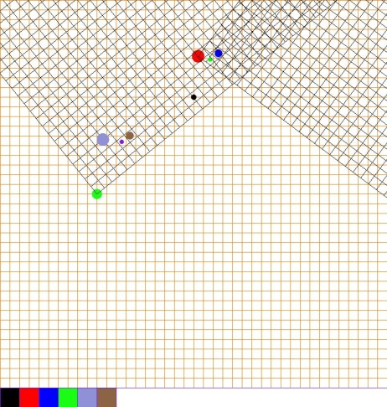
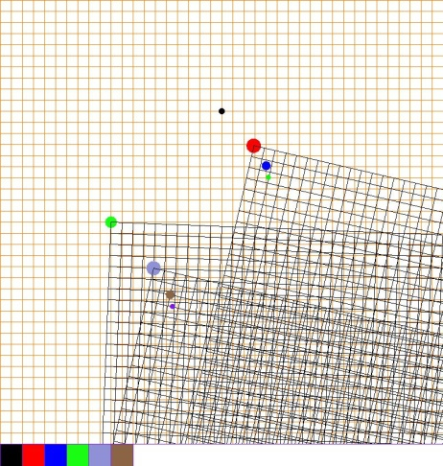
void draw() {
background(White);
OG.Show();
pushMatrix();
fill(Black);
stroke(Black);
ellipse(400, 200, 10, 10);
translate(400, 200);
rotate(i * Unit);
if(Q_ShowB[0]) {
BG.Show();
}
fill(Red);
stroke(Red);
ellipse(60, 60, 25, 25);
………………………………………………..
popMatrix();
pushMatrix();
fill(C1);
stroke(C1);
ellipse(200, 400, 20, 20);
translate(200, 400);
rotate(i * Unit);
if(Q_ShowB[3]) {
BG.Show();
}
fill(C2);
stroke(C2);
ellipse(80, 80, 25, 25);
………………………………………………………………………..
popMatrix();
…………………………….
}
Here you can select or deselect the frame of reference grids by clicking on the appropriately coloured button
SolarSystemPushPopGrid1

Slide 11
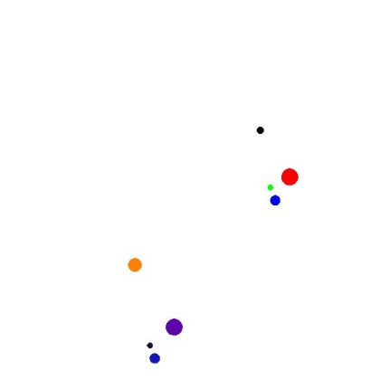
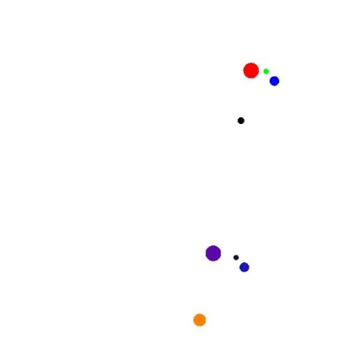
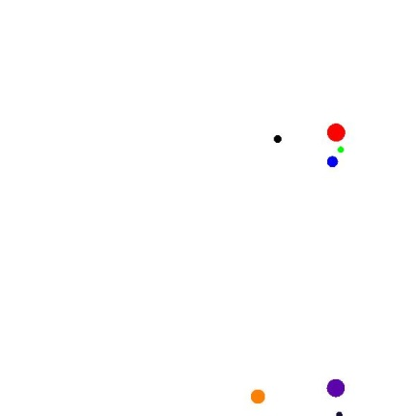
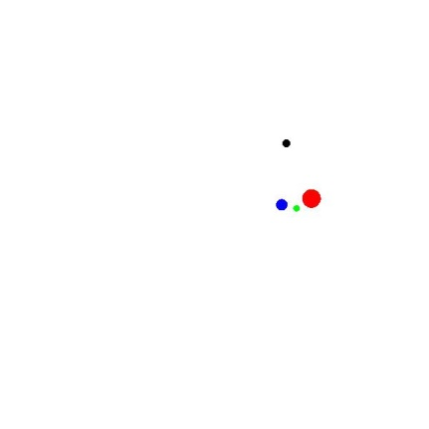
The sun of the first solar system stays in fixed position. All its attendants ‘follow it’ in their various orbits.
pushMatrix();
fill(Black);
stroke(Black);
……………………..
popMatrix();
pushMatrix();
fill(Orange);
stroke(Orange);
ellipse(200 + i/10, 400 + i/10, 20, 20);
translate(200 + i/10, 400 + i/10);
rotate(i * Unit);
fill(C1);
stroke(C1);
ellipse(80, 80, 25, 25);
translate(80, 80);
rotate(5 * i * Unit);
fill(C2);
stroke(C2);
ellipse(40, 40, 15, 15);
translate(40, 40);
rotate(10 * i * Unit);
stroke(C3);
fill(C3);
ellipse(15, 15, 8, 8);
popMatrix();
i++;
}
The sun of the second solar system moves 1/10 right and i/10 down each ‘instant’ – i.e. frameclick. All its attendants ‘follow it’ in their various orbits.
SolarSystemPushPop2

Slide 12
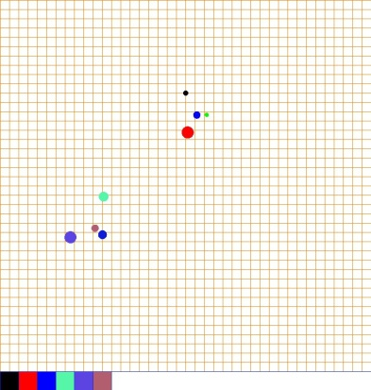
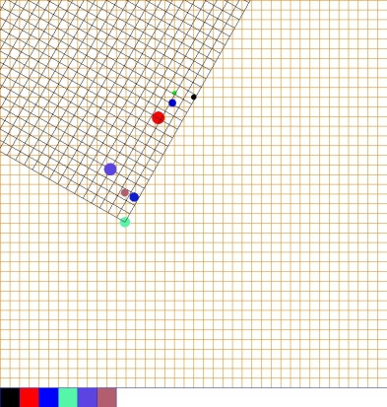
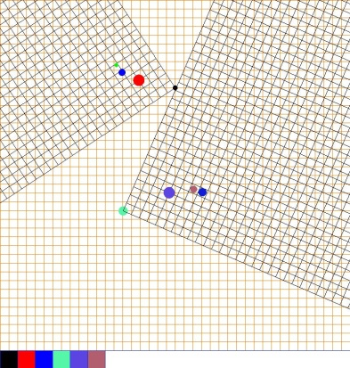
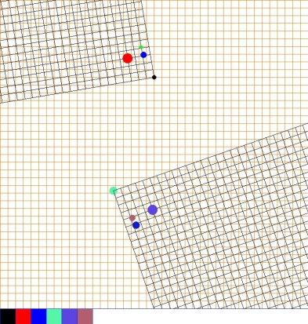
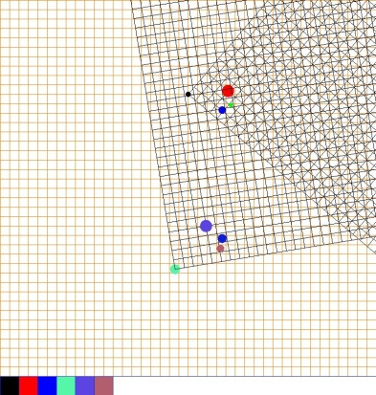
The grids show that the green sun is moving down and right, taking its ‘family’ with it.
SolarSystemPushPopGrid2

Slide 13
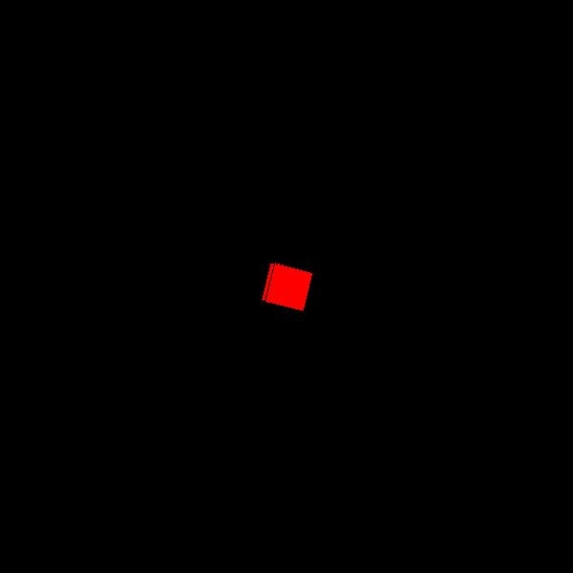
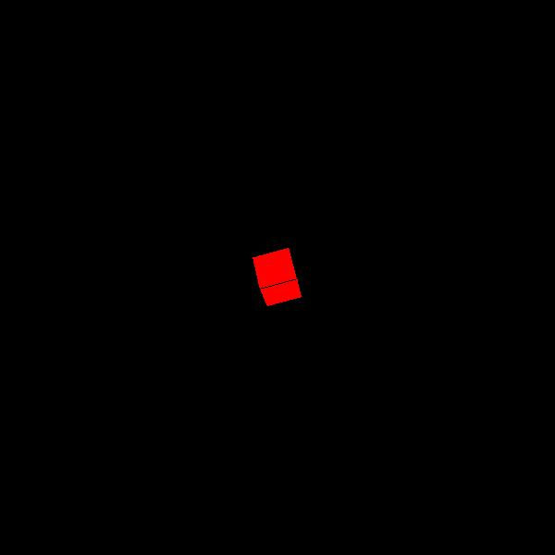
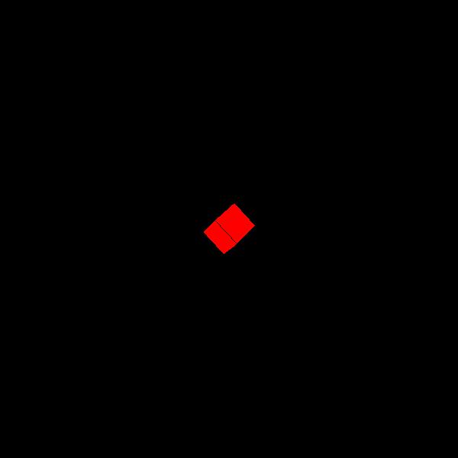
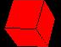
int W = 600,
H = W;
int N = 40;
void setup() {
size(W, H, P3D);
}
void draw() {
background(0);
translate(W/2, H/2);
rotateY(frameCount*PI/mouseX);
rotateX(frameCount*PI/mouseY);
rotateZ(frameCount*PI/600);
fill(Red);
box(N, N, N);
}
Rotation about the x axis
X axis
Rotation about the y axis
The system variable frameCount contains the number of frames that have been displayed since the program started. Inside setup() the value is 0, after the first iteration of draw it is 1, etc.
Cube1

Slide 14
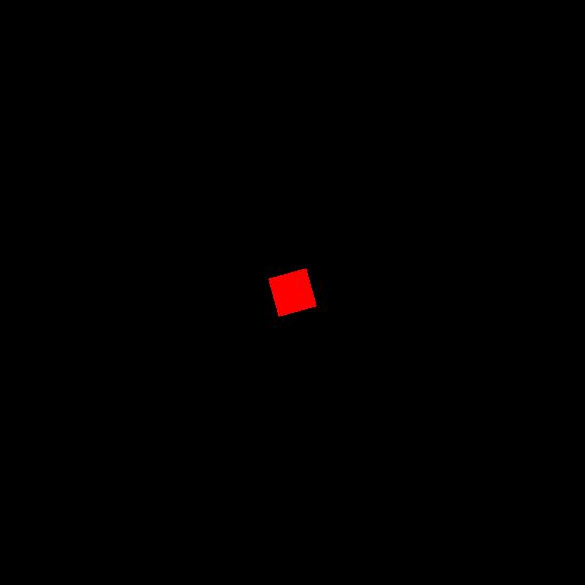
y
x
Rotation about the z axis
Cube1

Slide 15
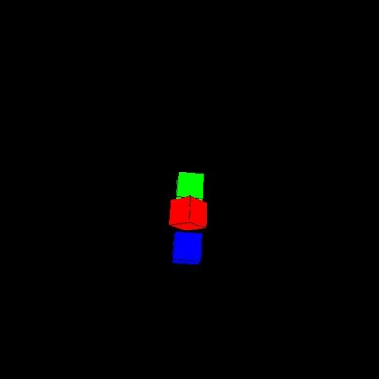
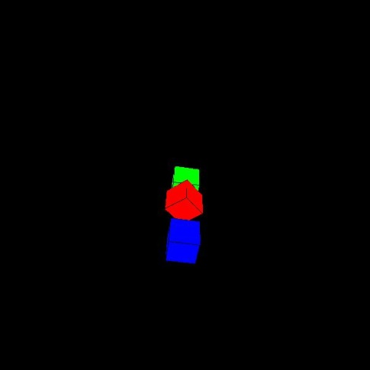
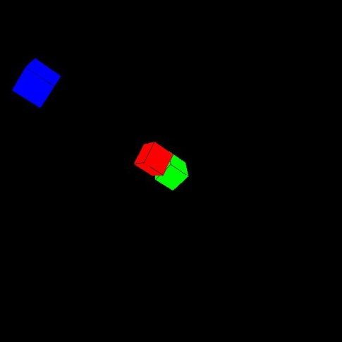
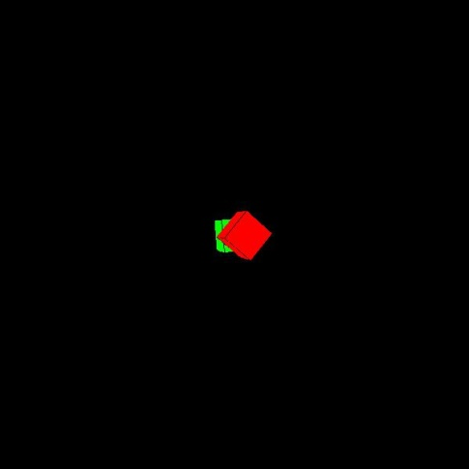
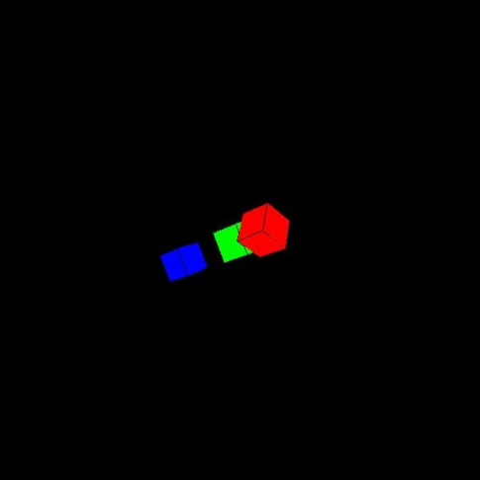
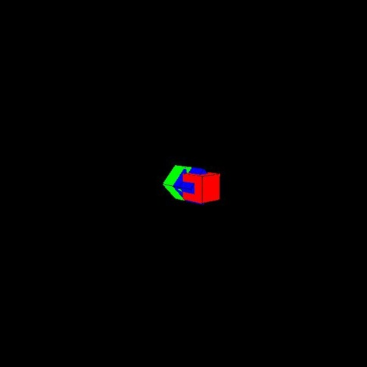
int W = 600,
H = W;
int N = 40;
int i = 0;
void setup() {
size(W, H, P3D);
}
void draw() {
background(0);
translate(W/2, H/2);
rotateY(frameCount*PI/mouseX);
rotateX(frameCount*PI/mouseY);
rotateZ(frameCount*PI/600);
fill(Green);
box(N, N, N);
pushMatrix();
translate(0, N);
rotateY(PI/4);
fill(Red);
box(N, N, N);
popMatrix();
fill(Blue);
translate(0, 2 * N + i);
box(N, N, N);
i++;
}
void mouseClicked() {
i = -i;
}
Cube2

Slide 16
int W = 600,
H = W;
Vector V;
int N = 40;
color[] Cols = new color[8];
void setup() {
int i;
size(W, H, P3D);
for(i = 0; i < 8; i++) {
Cols[i] = RandCol();
}
}
color BBB(int i) {
if (random(100) < 1) {
Cols[i] = RandCol();
}
return(Cols[i]);
}
Cube3

Slide 17
void draw() {
background(0);
translate(W/2, H/2);
rotateY(frameCount*PI/mouseX);
rotateX(frameCount*PI/mouseY);
rotateZ(frameCount*PI/600);
//Box 0
pushMatrix();
translate(0, 0, 0);
fill(BBB(0));
box(N, N, N);
popMatrix();
//Box 1
pushMatrix();
translate(N, 0);
fill(BBB(1));
box(N, N, N);
popMatrix();
//Box 2
pushMatrix();
translate(-N, 0);
fill(BBB(2));
box(N, N, N);
popMatrix();
//Box 3
pushMatrix();
translate(0, -N);
fill(BBB(3));
box(N, N, N);
popMatrix();
//Box 4
pushMatrix();
translate(0, N);
fill(BBB(4));
box(N, N, N);
popMatrix();
//Box 5
pushMatrix();
translate(0, 0, -N);
fill(BBB(5));
box(N, N, N);
popMatrix();
//Box 6
pushMatrix();
translate(0, 0, N);
fill(BBB(6));
box(N, N, N);
popMatrix();
//Box 7
pushMatrix();
translate(0, 0, 2*N);
fill(BBB(7));
box(N, N, N);
popMatrix();
}
Cube3

Slide 18
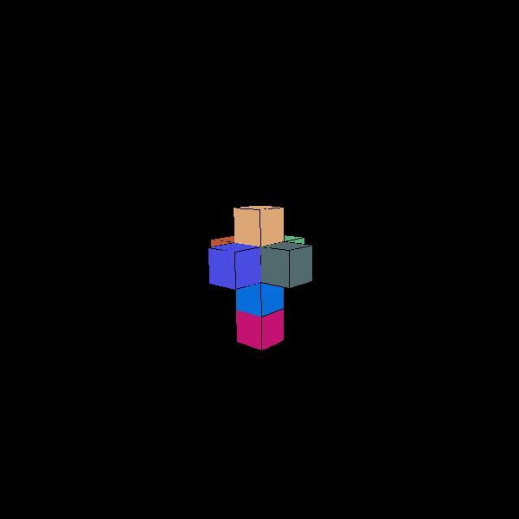
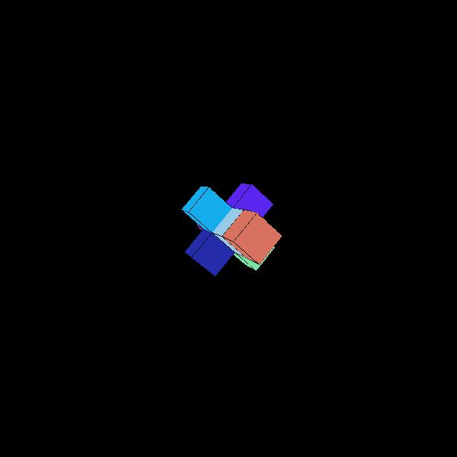

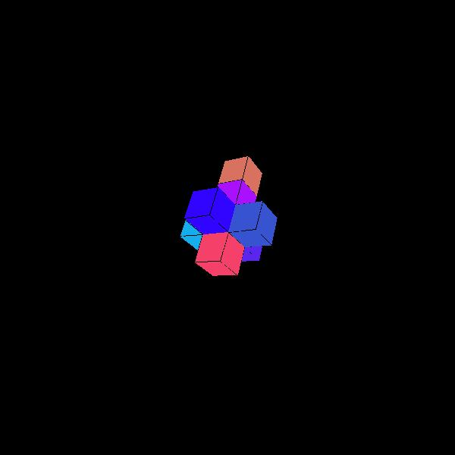

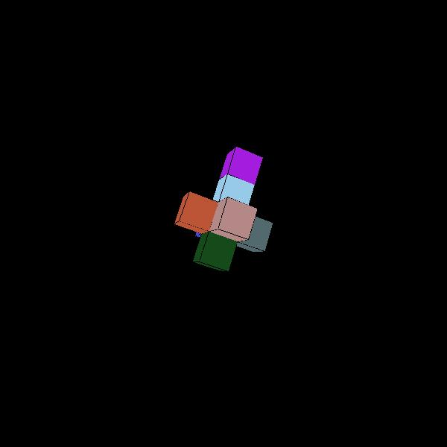
Cube3

